Slide 1
Mercury Pollution
The other global environmental crisis

Slide 2
Mercury – why the concern?
Mercury (Hg) is a natural element found in the earth’s crust & significant exposure to elemental Hg is rare (occupational);
But methylmercury is a potent develop-mental neurotoxin, pervasive in the marine food chain due to industrial pollution;
The crisis is the dependence of many humans & wildlife on aquatic food sources.

Slide 3
How Potent?
Based on recent population studies, MeHg effects may start at 0.2 millionth of an ounce per day*
For an adult female (fetus receptor)
Methyl mercury readily passes through the placenta and blood-brain barrier; concentrates in fetus;
Causes mental retardation & decrements in memory, attention, language and visual-motor skills in childhood.
*the current EPA reference dose.

Slide 4
Modes of Exposure
Over 90% of exposure is through consumption of commercially caught marine fish;
But very high exposure is possible from eating predator fish from fresh surface waters or marine estuaries polluted by a large emission source(s);
Especially where rapid methylation is achieved in wetlands or bodies with fluctuating water levels characterized by anaerobic, acidic waters high in dissolved organic matter.

Slide 5
Current Body Burden – females of child-bearing age
Body burden/exposure accurately measured in hair or blood;
Between 8 & 16%* of US women living in US coastal regions (1 in 6) have body-burden above impact level;
Highest global burden is 28% of Korean women;
Half-life of methyl mercury in blood is 50 – 70 days.
* High end reflects bio-magnification of MeHg in fetus

Slide 6
Wildlife is being impacted by current levels of food-chain contamination
Recent studies indicate fish reproduction is impaired at current mercury body levels;
Same for fish-eating birds like loons, bald eagles & wading birds;
Also fish eating mammals like mink & river otters;
Even song birds & bats who eat lower on food chain.

Slide 7
The Health Paradox
Recent research has also identified important benefits of eating fish especially to child brain development;
Discussion of harms and benefits of eating fish is a separate presentation;
Today I will focus mainly on why we have the mercury pollution problem & its similarity to the climate change issue.

Slide 8
Mercury and the Anthropocene
Definitions:
-- anthropogenic: caused by humans
-- anthropocene: proposed new geological epoch to
acknowledge the massive impact by humans on the planet;
Use of mercury goes back several millennia & current Hg deposition is estimated to be 7 times prior to humans;
Current deposition is estimated to be at least 3 times the beginning of the industrial age (mid-19th century);
So mercury is a subtle, long term, anthropogenic pollutant in many ways similar to the principal greenhouse gases (GHG’s) which are carbon dioxide and methane;

Slide 9
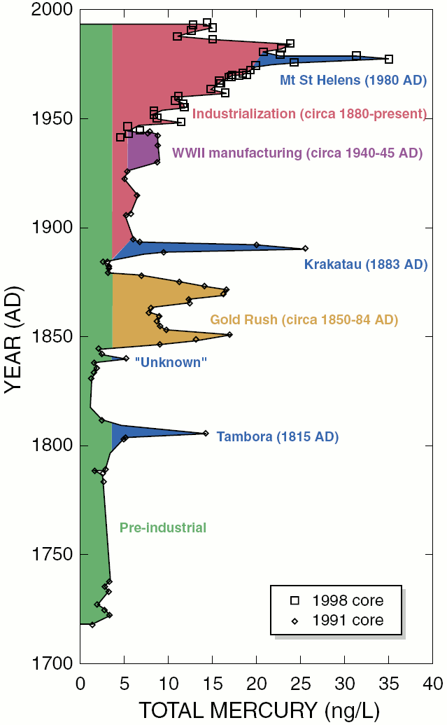
Wyoming Glacial Ice Core
Mercury Deposition increase since pre-industrial times
Other major mercury use periods in
the past are Spanish new-world gold
and silver mining & heavy use by
Greeks & Romans.

Slide 10
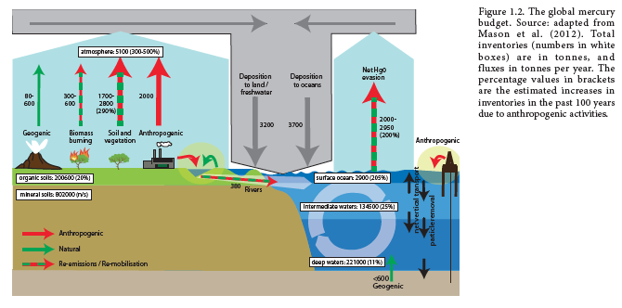
Global Mercury Cycle

Slide 11
Sources of Emissions to Air
Natural emissions:* 10%
Anthropogenic emissions: 25%
Biomass burning : 5%
Re-emission from land: 30%
Re-emission from ocean: 30%
*About half of this is geo-genic emissions to ocean that may not be in place to be re-emitted to the atmosphere

Slide 12
Atmospheric Residence Time
Elemental mercury, Hg(0) is several months to a year;
Reactive gaseous mercury(RGM), Hg(II) is hours to days;
Thus RGM is crucial to local deposition from an industrial source.

Slide 13
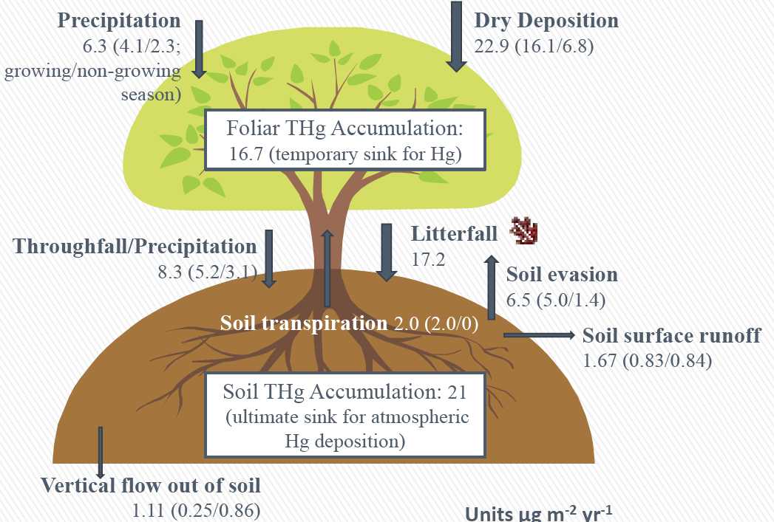
Fate of Hg Deposition

Slide 14
2005 Anthropogenic emissions (metric tons)
Human or Industrial activity
Industrial Byproduct: stationary combustion (coal, etc) | 880
Metals mining and production | 187
Cement production | 189
Large scale gold production | 111
Mercury production | 9
Chlorine & NaOH production | 47
Total industrial byproduct |  | 1423
Product use (landfill evasion, burning waste, etc) |  | 131
Artisanal gold mining (small scale) |  | 350
Cremation |  | 26
Total of all anthropogenic sources |  | 1930

Slide 15
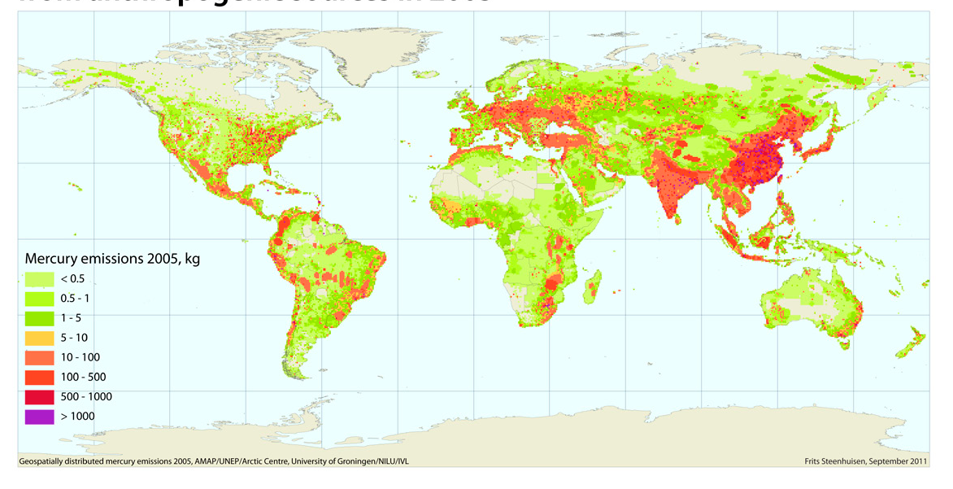
Principal Anthropogenic Emission
Sources: Hot Spots

Slide 16
Reservoir Effect
Large legacy reservoir of past emissions in surface soil, biota and water;
Some mercury is re-emitted after original deposition,
especially from surface layer of the ocean, and
from land surface, especially when warmed;
Time scale for removal of legacy emissions from the mercury cycle is about 2000 years;
Even after new anthropogenic emissions are reduced or eliminated there will be a long delay in return to natural background levels (like GHG’s);

Slide 17
Major Challenges
100 million people depend on artisanal gold mining, primarily in developing countries;
With over 2000 coal-fired power plants China accounts for about 40% of current total emissions (but much of “legacy” now being re-emitted came from US & Europe, esp. gold & silver mining);
US, China and India account for 60%.

Slide 18
The Current Dilemna
Recent research has detected a decline in ambient contamination levels in the North Atlantic region that tracks declines in anthropogenic emissions in the US and Europe;
But emissions are growing rapidly in Asia that are globally mobile;
Problem is identical to GHG trends

Slide 19
Fish Consumption Advisories
Methylmercury in Seafood (parts per million, wet weight) | Consumption Guidance
<or = 0.05 | Unrestricted
0.05 – 0.11 | 2 meals per week
0.11 – 0.22 | 1 meal per week
0.22 – 0.95 | 1 meal per month
>0.95 | No consumption
Based on EPA reference dose and a meal size of 170 grams/6oz

Slide 20
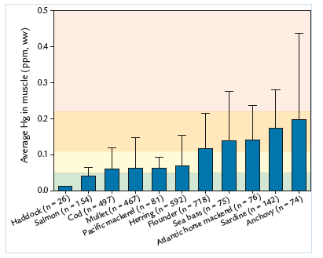
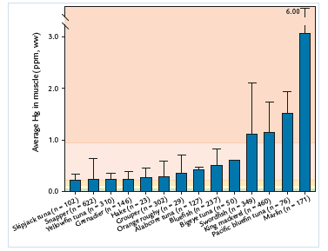
Mercury Risk with Marine Fish
0.23
Safer
Not so safe
Source: Biodiversity Research Institute (BRI)

Slide 21
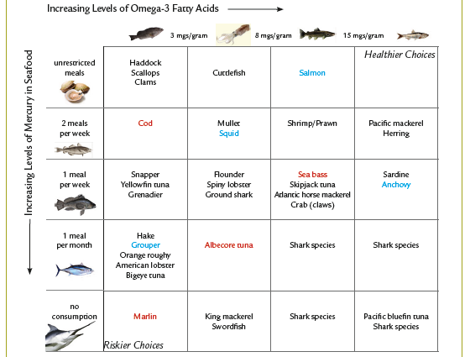
Omega 3 Counter-effects Source - BRI

Slide 22
Marine Mammals:
Seals, porpoises and meat-eating whales
average 5 ppm body burden;
Impact on animal reproduction unknown though some evidence for evolutionary adaptation & immunity;
Serious impact on remote human populations, like Inuit, who depend on eating marine mammals.

Slide 23
US Fresh Water Contamination: EPA National Lake Fish Tissue Study (2009)
50 Percentile value in predator fish = 285 parts per billion;
Therefore more than 50% of predator fish in US freshwater lakes exceed the 230 ppb contamination threshold for 1 meal per month;
50 percentile value in bottom dwelling fish = 69 parts per billion

Slide 24
New Kansas Guidance
Previously, for women of childbearing age and children under 12: one meal per week of locally caught fish;
Now, one meal per month of top predator fish: large & smallmouth, spotted bass for these most sensitive populations;*
Missouri advisory very similar.
*Result of new testing method: individual fish samples instead of mixed filets of 3 to 6 individuals.

Slide 25
Local Wet Deposition of Mercury

Slide 28
Current Prospects for Action
US is just now requiring new controls on coal fired power plants by 2016; also cement kilns, but loophole for CK’s that burn hazardous waste;
Europe took action 20 years ago;
Widely recognized that international co-operation is crucial due to Asian emissions.

Slide 29
A Step Forward
140 nations agreed to the Minimata Convention in January, ‘13;
By 2020, reduce emissions from coal plants, gold mines and some factories;
Regulate use of mercury in everyday products like batteries, fluorescent lamps, cosmetics; Also medical devices;
Criticized by some as vague and too slow.
Will it work better than climate change treaties? - requires some of the same universal actions related to economic growth

Slide 30
Ultimate Solution
Humans dug up and liberated stable forms of mercury from its global geological reservoir;
Humans did not evolve with current levels of contamination
Anthropogenic emissions must be eliminated so biologically active mercury can exit the system over time in sediment;
Similar to the GHG problem.

